Slide 1




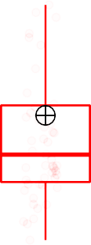
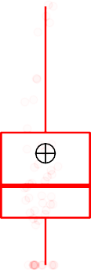
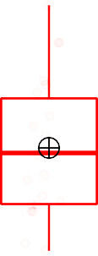

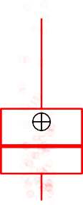

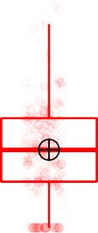



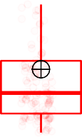



Aspergillus rambellii
8 cohorts has same trend in CRC entiched. 7 cohorts play significant different.
Stage
CTRL
CRC
Wilcoxon, p = 0.0018
Wilcoxon, p = 0.052
Wilcoxon, p = 6.1e−05
Wilcoxon, p = 2.7e−05
Wilcoxon, p = 0.0034
Wilcoxon, p = 1.4e−06
Wilcoxon, p = 7.5e−05
Wilcoxon, p = 0.001
1.2
acsin 3th square root of Aspergillus rambellii
0.8
0.4
0.0
2015_FengQ
2016_VogtmannE
2019_Thom
2019_WirbelJ
2019_Yachida
2021_JunY_1
2021_JunY_2

Slide 2



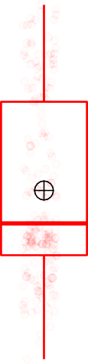


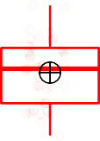
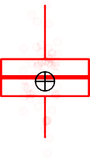


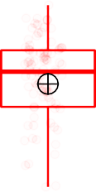

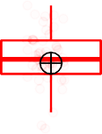
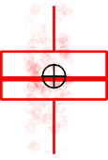

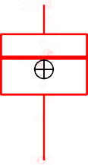


Rhizophagus irregularis
7 cohorts has same trend in CRC depleted. 6 cohorts play significant different.
Stage
CTRL
CRC
1.00
Wilcoxon, p = 7.9e−07
Wilcoxon, p = 0.37
Wilcoxon, p = 0.029
Wilcoxon, p = 0.14
Wilcoxon, p = 0.00085
Wilcoxon, p = 7.6e−05
Wilcoxon, p = 0.026
Wilcoxon, p = 3.5e−05
acsin 3th square root of Rhizophagus irregularis
0.75
0.50
0.25
0.00
2014_ZellerG
2015_FengQ
2016_VogtmannE
2019_Thom
2019_WirbelJ
2019_Yachida
2021_JunY_1
2021_JunY_2
Cohort

Slide 3







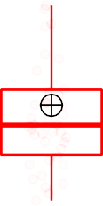
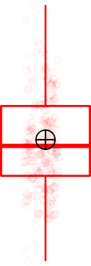



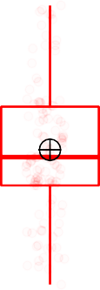
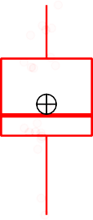

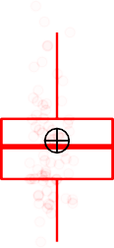
Leucoagaricus sp. SymC.cos
7 cohorts has same trend in CRC depleted. 6 cohorts play significant different.
Stage
CTRL
CRC
acsin 3th square root of Leucoagaricus sp. SymC.cos
0.4
Wilcoxon, p = 0.0014
Wilcoxon, p = 0.032
Wilcoxon, p = 0.21
Wilcoxon, p = 0.42
Wilcoxon, p = 0.00054
Wilcoxon, p = 0.011
Wilcoxon, p = 0.016
Wilcoxon, p = 4.1e−05
0.3
0.2
0.1
0.0
2015_FengQ
2016_VogtmannE
2019_Thom
2019_WirbelJ
2019_Yachida
2021_JunY_1
2021_JunY_2

Slide 4








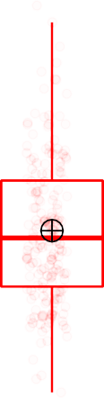




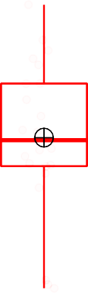

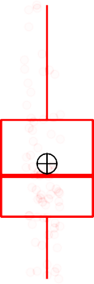
Piromyces sp. E2
7 cohorts has same trend in CRC depleted. 5 cohorts play significant different.
Stage
CTRL
CRC
Wilcoxon, p = 9e−04
Wilcoxon, p = 0.94
Wilcoxon, p = 0.059
Wilcoxon, p = 0.0061
Wilcoxon, p = 0.001
Wilcoxon, p = 0.095
Wilcoxon, p = 0.0047
Wilcoxon, p = 0.018
acsin 3th square root of Piromyces sp. E2
0.3
0.2
0.1
0.0
2015_FengQ
2016_VogtmannE
2019_Thom
2019_WirbelJ
2019_Yachida
2021_JunY_1
2021_JunY_2

Slide 5







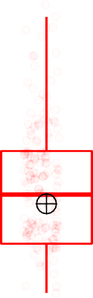


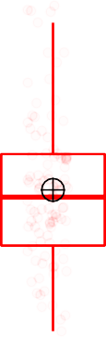




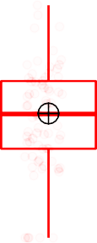
Hanseniaspora opuntiae
7 cohorts has same trend in CRC depleted. 5 cohorts play significant different.
Stage
CTRL
CRC
Wilcoxon, p = 0.047
Wilcoxon, p = 0.69
Wilcoxon, p = 0.26
Wilcoxon, p = 0.011
Wilcoxon, p = 0.0025
Wilcoxon, p = 0.96
Wilcoxon, p = 0.00037
Wilcoxon, p = 0.014
acsin 3th square root of Hanseniaspora opuntiae
0.20
0.15
0.10
0.05
0.00
2014_ZellerG
2015_FengQ
2016_VogtmannE
2019_Thom
2019_WirbelJ
2019_Yachida
2021_JunY_1
2021_JunY_2
Cohort

Slide 6








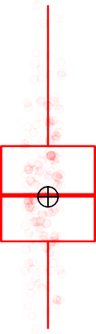


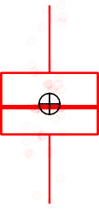

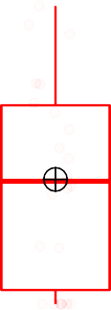


Torulaspora delbrueckii
7 cohorts has same trend in CRC depleted. 5 cohorts play significant different.
Stage
CTRL
CRC
Wilcoxon, p = 0.00081
Wilcoxon, p = 0.0095
Wilcoxon, p = 0.28
Wilcoxon, p = 0.24
Wilcoxon, p = 0.018
Wilcoxon, p = 0.43
Wilcoxon, p = 0.0022
Wilcoxon, p = 0.00049
acsin 3th square root of Torulaspora delbrueckii
0.2
0.1
0.0
2015_FengQ
2016_VogtmannE
2019_Thom
2019_WirbelJ
2019_Yachida
2021_JunY_1
2021_JunY_2

Slide 7














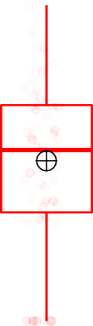
Coccidioides immitis
7 cohorts has same trend in CRC depleted. 5 cohorts play significant different.
Stage
CTRL
CRC
Wilcoxon, p = 0.009
Wilcoxon, p = 0.25
Wilcoxon, p = 0.61
Wilcoxon, p = 0.02
Wilcoxon, p = 0.032
Wilcoxon, p = 0.28
Wilcoxon, p = 0.0081
Wilcoxon, p = 0.048
acsin 3th square root of Coccidioides immitis
0.20
0.15
0.10
0.05
0.00
2014_ZellerG
2015_FengQ
2016_VogtmannE
2019_Thom
2019_WirbelJ
2019_Yachida
2021_JunY_1
2021_JunY_2
Cohort

Slide 8









Aspergillus kawachii
7 cohorts has same trend in CRC depleted. 5 cohorts play significant different.
Stage
CTRL
CRC
Wilcoxon, p = 0.02
Wilcoxon, p = 0.49
Wilcoxon, p = 0.021
Wilcoxon, p = 0.91
Wilcoxon, p = 0.012
Wilcoxon, p = 0.66
Wilcoxon, p = 0.0039
Wilcoxon, p = 0.0018
acsin 3th square root of Aspergillus kawachii
0.2
0.1
0.0
2015_FengQ
2016_VogtmannE
2019_Thom
2019_WirbelJ
2019_Yachida
2021_JunY_1
2021_JunY_2

Slide 9




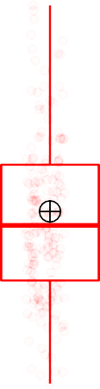





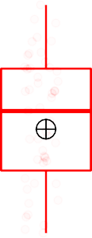

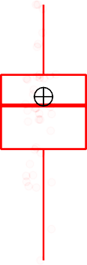



Trichoderma atroviride
7 cohorts has same trend in CRC depleted. 5 cohorts play significant different.
Stage
CTRL
CRC
Wilcoxon, p = 0.018
Wilcoxon, p = 0.014
Wilcoxon, p = 0.64
Wilcoxon, p = 0.8
Wilcoxon, p = 0.0032
Wilcoxon, p = 0.81
Wilcoxon, p = 0.02
Wilcoxon, p = 5.9e−08
acsin 3th square root of Trichoderma atroviride
0.2
0.1
0.0
2015_FengQ
2016_VogtmannE
2019_Thom
2019_WirbelJ
2019_Yachida
2021_JunY_1
2021_JunY_2

Slide 10




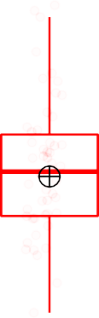


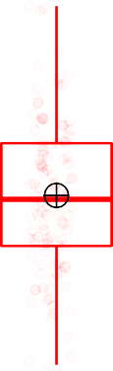
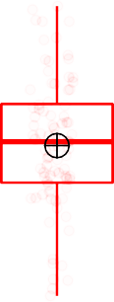



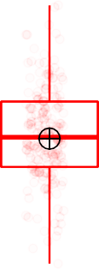


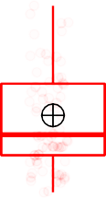
Batrachochytrium salamandrivorans
8 cohorts has same trend in CRC depleted. 4 cohorts play significant different.
Stage
CTRL
CRC
acsin 3th square root of Batrachochytrium salamandrivorans
0.3
Wilcoxon, p = 0.031
Wilcoxon, p = 0.04
Wilcoxon, p = 0.73
Wilcoxon, p = 1
Wilcoxon, p = 0.13
Wilcoxon, p = 0.98
Wilcoxon, p = 0.019
Wilcoxon, p = 0.0016
0.2
0.1
0.0
2015_FengQ
2016_VogtmannE
2019_Thom
2019_WirbelJ
2019_Yachida
2021_JunY_1
2021_JunY_2

Slide 11


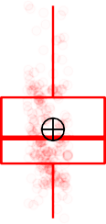

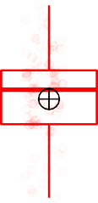

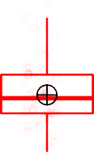

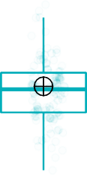
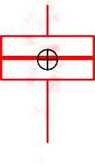


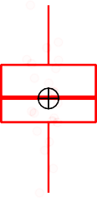
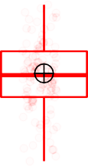

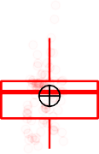
Mucor circinelloides
7 cohorts has same trend in CRC depleted. 4 cohorts play significant different.
Stage
CTRL
CRC
Wilcoxon, p = 0.022
Wilcoxon, p = 0.95
Wilcoxon, p = 0.35
Wilcoxon, p = 0.52
Wilcoxon, p = 0.0015
Wilcoxon, p = 0.21
Wilcoxon, p = 0.0024
Wilcoxon, p = 0.0051
acsin 3th square root of Mucor circinelloides
0.4
0.2
0.0
2015_FengQ
2016_VogtmannE
2019_Thom
2019_WirbelJ
2019_Yachida
2021_JunY_1
2021_JunY_2

Slide 12




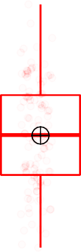
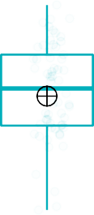
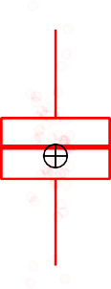
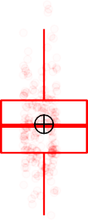

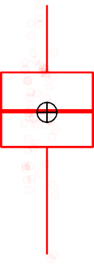

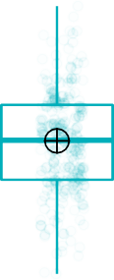




Edhazardia aedis
7 cohorts has same trend in CRC depleted. 4 cohorts play significant different.
Stage
CTRL
CRC
Wilcoxon, p = 2.6e−06
Wilcoxon, p = 0.82
Wilcoxon, p = 0.6
Wilcoxon, p = 0.91
Wilcoxon, p = 0.00043
Wilcoxon, p = 0.17
Wilcoxon, p = 0.00069
Wilcoxon, p = 3.7e−05
0.4
acsin 3th square root of Edhazardia aedis
0.3
0.2
0.1
0.0
2015_FengQ
2016_VogtmannE
2019_Thom
2019_WirbelJ
2019_Yachida
2021_JunY_1
2021_JunY_2

Slide 13















Encephalitozoon hellem
8 cohorts has same trend in CRC depleted. 4 cohorts play significant different.
Stage
CTRL
CRC
Wilcoxon, p = 0.026
Wilcoxon, p = 0.0052
Wilcoxon, p = 0.15
Wilcoxon, p = 0.13
Wilcoxon, p = 0.0028
Wilcoxon, p = 0.62
Wilcoxon, p = 0.022
Wilcoxon, p = 0.54
acsin 3th square root of Encephalitozoon hellem
0.15
0.10
0.05
0.00
2014_ZellerG
2015_FengQ
2016_VogtmannE
2019_Thom
2019_WirbelJ
2019_Yachida
2021_JunY_1
2021_JunY_2
Cohort

Slide 14















Tilletia controversa
7 cohorts has same trend in CRC entiched. 4 cohorts play significant different.
Stage
CTRL
CRC
Wilcoxon, p = 0.15
Wilcoxon, p = 0.00026
Wilcoxon, p = 0.18
Wilcoxon, p = 0.93
Wilcoxon, p = 0.0037
Wilcoxon, p = 0.91
Wilcoxon, p = 9.3e−07
Wilcoxon, p = 0.0036
acsin 3th square root of Tilletia controversa
0.3
0.2
0.1
0.0
2015_FengQ
2016_VogtmannE
2019_Thom
2019_WirbelJ
2019_Yachida
2021_JunY_1
2021_JunY_2

Slide 15
















Kwoniella pini
7 cohorts has same trend in CRC depleted. 4 cohorts play significant different.
Stage
CTRL
CRC
Wilcoxon, p = 0.0086
Wilcoxon, p = 0.59
Wilcoxon, p = 0.095
Wilcoxon, p = 0.13
Wilcoxon, p = 0.003
Wilcoxon, p = 0.42
Wilcoxon, p = 0.023
Wilcoxon, p = 0.0067
0.20
acsin 3th square root of Kwoniella pini
0.15
0.10
0.05
0.00
2014_ZellerG
2015_FengQ
2016_VogtmannE
2019_Thom
2019_WirbelJ
2019_Yachida
2021_JunY_1
2021_JunY_2
Cohort

Slide 16
















Komagataella pastoris
7 cohorts has same trend in CRC depleted. 4 cohorts play significant different.
Stage
CTRL
CRC
0.25
Wilcoxon, p = 0.017
Wilcoxon, p = 0.015
Wilcoxon, p = 0.4
Wilcoxon, p = 0.28
Wilcoxon, p = 0.0072
Wilcoxon, p = 0.31
Wilcoxon, p = 0.14
Wilcoxon, p = 0.035
acsin 3th square root of Komagataella pastoris
0.20
0.15
0.10
0.05
0.00
2014_ZellerG
2015_FengQ
2016_VogtmannE
2019_Thom
2019_WirbelJ
2019_Yachida
2021_JunY_1
2021_JunY_2
Cohort

Slide 17
















Brettanomyces bruxellensis
7 cohorts has same trend in CRC depleted. 4 cohorts play significant different.
Stage
CTRL
CRC
acsin 3th square root of Brettanomyces bruxellensis
Wilcoxon, p = 0.051
Wilcoxon, p = 0.031
Wilcoxon, p = 0.96
Wilcoxon, p = 0.36
Wilcoxon, p = 0.023
Wilcoxon, p = 0.96
Wilcoxon, p = 2.1e−05
Wilcoxon, p = 0.00061
0.20
0.15
0.10
0.05
0.00
2014_ZellerG
2015_FengQ
2016_VogtmannE
2019_Thom
2019_WirbelJ
2019_Yachida
2021_JunY_1
2021_JunY_2
Cohort

Slide 18
















Debaryomyces hansenii
7 cohorts has same trend in CRC depleted. 4 cohorts play significant different.
Stage
CTRL
CRC
0.6
Wilcoxon, p = 0.0028
Wilcoxon, p = 0.75
Wilcoxon, p = 0.026
Wilcoxon, p = 0.41
Wilcoxon, p = 0.062
Wilcoxon, p = 0.52
Wilcoxon, p = 0.0015
Wilcoxon, p = 0.00023
acsin 3th square root of Debaryomyces hansenii
0.4
0.2
0.0
2015_FengQ
2016_VogtmannE
2019_Thom
2019_WirbelJ
2019_Yachida
2021_JunY_1
2021_JunY_2

Slide 19
















Hyphopichia burtonii
7 cohorts has same trend in CRC depleted. 4 cohorts play significant different.
Stage
CTRL
CRC
Wilcoxon, p = 0.00041
Wilcoxon, p = 0.59
Wilcoxon, p = 0.56
Wilcoxon, p = 0.57
Wilcoxon, p = 0.00092
Wilcoxon, p = 0.18
Wilcoxon, p = 0.0021
Wilcoxon, p = 0.0061
acsin 3th square root of Hyphopichia burtonii
0.20
0.15
0.10
0.05
0.00
2014_ZellerG
2015_FengQ
2016_VogtmannE
2019_Thom
2019_WirbelJ
2019_Yachida
2021_JunY_1
2021_JunY_2
Cohort

Slide 20
















Eremothecium sinecaudum
7 cohorts has same trend in CRC depleted. 4 cohorts play significant different.
Stage
CTRL
CRC
acsin 3th square root of Eremothecium sinecaudum
Wilcoxon, p = 0.03
Wilcoxon, p = 0.2
Wilcoxon, p = 0.27
Wilcoxon, p = 0.63
Wilcoxon, p = 0.008
Wilcoxon, p = 0.017
Wilcoxon, p = 0.24
Wilcoxon, p = 0.0042
0.2
0.1
0.0
2015_FengQ
2016_VogtmannE
2019_Thom
2019_WirbelJ
2019_Yachida
2021_JunY_1
2021_JunY_2

Slide 21
















Torulaspora globosa
7 cohorts has same trend in CRC depleted. 4 cohorts play significant different.
Stage
CTRL
CRC
0.20
Wilcoxon, p = 0.16
Wilcoxon, p = 0.69
Wilcoxon, p = 0.75
Wilcoxon, p = 0.95
Wilcoxon, p = 0.0025
Wilcoxon, p = 0.0095
Wilcoxon, p = 0.0043
Wilcoxon, p = 1.8e−05
acsin 3th square root of Torulaspora globosa
0.15
0.10
0.05
0.00
2014_ZellerG
2015_FengQ
2016_VogtmannE
2019_Thom
2019_WirbelJ
2019_Yachida
2021_JunY_1
2021_JunY_2
Cohort

Slide 22
















Tuber magnatum
7 cohorts has same trend in CRC depleted. 4 cohorts play significant different.
Stage
CTRL
CRC
Wilcoxon, p = 0.033
Wilcoxon, p = 0.0053
Wilcoxon, p = 0.79
Wilcoxon, p = 0.58
Wilcoxon, p = 0.00018
Wilcoxon, p = 0.78
Wilcoxon, p = 0.1
Wilcoxon, p = 0.0059
acsin 3th square root of Tuber magnatum
0.3
0.2
0.1
0.0
2015_FengQ
2016_VogtmannE
2019_Thom
2019_WirbelJ
2019_Yachida
2021_JunY_1
2021_JunY_2

Slide 23
















Pseudocercospora fijiensis
7 cohorts has same trend in CRC depleted. 4 cohorts play significant different.
Stage
CTRL
CRC
0.3
Wilcoxon, p = 0.036
Wilcoxon, p = 0.24
Wilcoxon, p = 0.9
Wilcoxon, p = 0.33
Wilcoxon, p = 0.035
Wilcoxon, p = 0.65
Wilcoxon, p = 0.043
Wilcoxon, p = 0.0014
acsin 3th square root of Pseudocercospora fijiensis
0.2
0.1
0.0
2015_FengQ
2016_VogtmannE
2019_Thom
2019_WirbelJ
2019_Yachida
2021_JunY_1
2021_JunY_2

Slide 24
















Emmonsia sp. CAC−2015a
7 cohorts has same trend in CRC depleted. 4 cohorts play significant different.
Stage
CTRL
CRC
0.3
Wilcoxon, p = 0.033
Wilcoxon, p = 0.033
Wilcoxon, p = 0.19
Wilcoxon, p = 0.85
Wilcoxon, p = 0.00021
Wilcoxon, p = 0.77
Wilcoxon, p = 0.082
Wilcoxon, p = 0.014
acsin 3th square root of Emmonsia sp. CAC−2015a
0.2
0.1
0.0
2015_FengQ
2016_VogtmannE
2019_Thom
2019_WirbelJ
2019_Yachida
2021_JunY_1
2021_JunY_2

Slide 25
















Rutstroemia sp. NJR−2017a BVV2
7 cohorts has same trend in CRC depleted. 4 cohorts play significant different.
Stage
CTRL
CRC
acsin 3th square root of Rutstroemia sp. NJR−2017a BVV2
Wilcoxon, p = 0.43
Wilcoxon, p = 0.096
Wilcoxon, p = 0.05
Wilcoxon, p = 0.46
Wilcoxon, p = 0.0075
Wilcoxon, p = 0.017
Wilcoxon, p = 0.22
Wilcoxon, p = 0.00017
0.15
0.10
0.05
0.00
2014_ZellerG
2015_FengQ
2016_VogtmannE
2019_Thom
2019_WirbelJ
2019_Yachida
2021_JunY_1
2021_JunY_2
Cohort

Slide 26
















Rutstroemia sp. NJR−2017a WRK4
7 cohorts has same trend in CRC depleted. 4 cohorts play significant different.
Stage
CTRL
CRC
acsin 3th square root of Rutstroemia sp. NJR−2017a WRK4
Wilcoxon, p = 0.036
Wilcoxon, p = 0.01
Wilcoxon, p = 0.66
Wilcoxon, p = 0.53
Wilcoxon, p = 0.0055
Wilcoxon, p = 0.75
Wilcoxon, p = 0.81
Wilcoxon, p = 0.0014
0.2
0.1
0.0
2015_FengQ
2016_VogtmannE
2019_Thom
2019_WirbelJ
2019_Yachida
2021_JunY_1
2021_JunY_2

Slide 27
















Thielaviopsis punctulata
7 cohorts has same trend in CRC entiched. 4 cohorts play significant different.
Stage
CTRL
CRC
Wilcoxon, p = 0.039
Wilcoxon, p = 0.41
Wilcoxon, p = 0.034
Wilcoxon, p = 0.39
Wilcoxon, p = 0.57
Wilcoxon, p = 0.025
Wilcoxon, p = 1.5e−05
Wilcoxon, p = 0.47
acsin 3th square root of Thielaviopsis punctulata
0.2
0.1
0.0
2015_FengQ
2016_VogtmannE
2019_Thom
2019_WirbelJ
2019_Yachida
2021_JunY_1
2021_JunY_2

Slide 28
















Colletotrichum fioriniae
7 cohorts has same trend in CRC depleted. 4 cohorts play significant different.
Stage
CTRL
CRC
Wilcoxon, p = 0.84
Wilcoxon, p = 0.019
Wilcoxon, p = 0.063
Wilcoxon, p = 0.61
Wilcoxon, p = 0.03
Wilcoxon, p = 0.48
Wilcoxon, p = 0.016
Wilcoxon, p = 0.00045
acsin 3th square root of Colletotrichum fioriniae
0.20
0.15
0.10
0.05
0.00
2014_ZellerG
2015_FengQ
2016_VogtmannE
2019_Thom
2019_WirbelJ
2019_Yachida
2021_JunY_1
2021_JunY_2
Cohort

